Slide 1
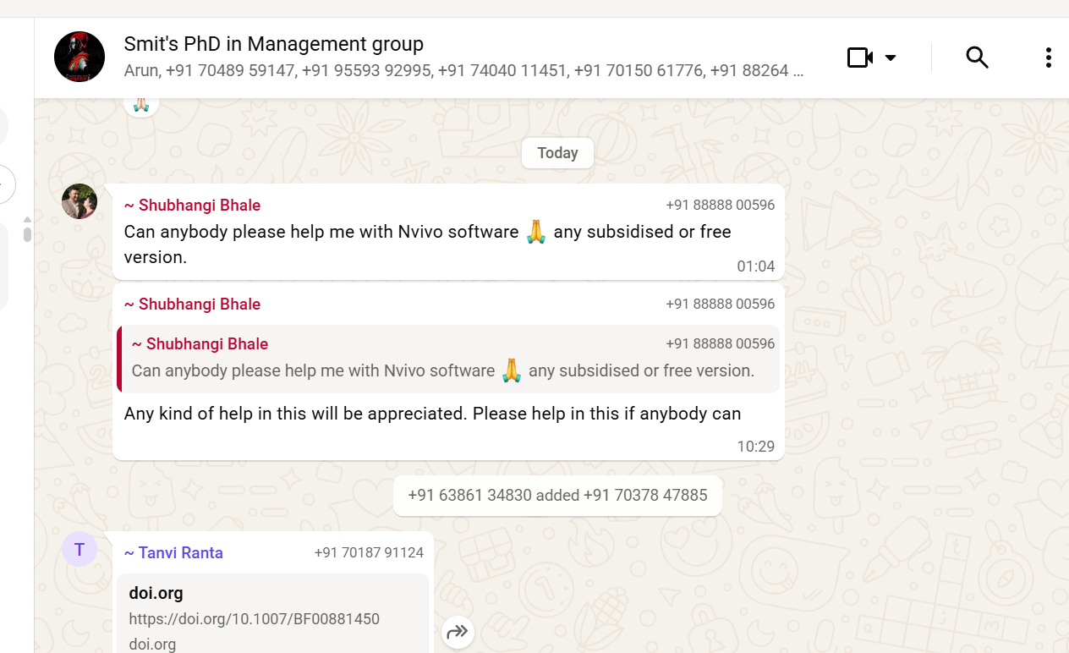
NAVALQDA Origins

